Slide 1
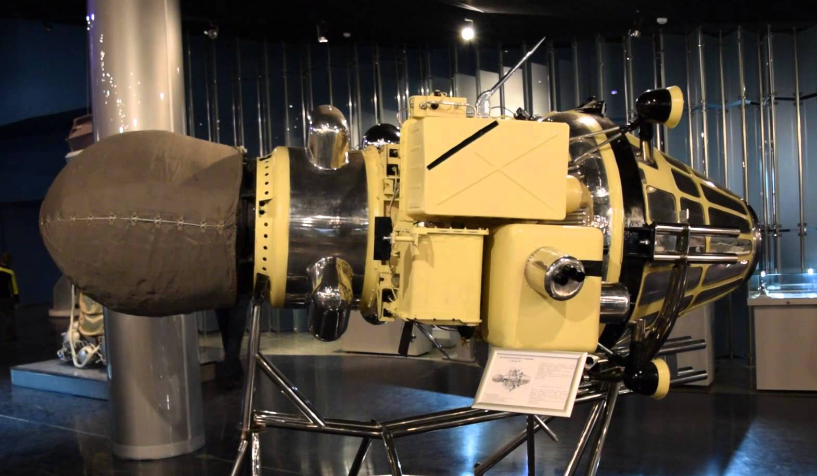
The Hunt for Luna 9 (and 13 too)
Jeff Plescia
SRE
June 16, 2016

Slide 2
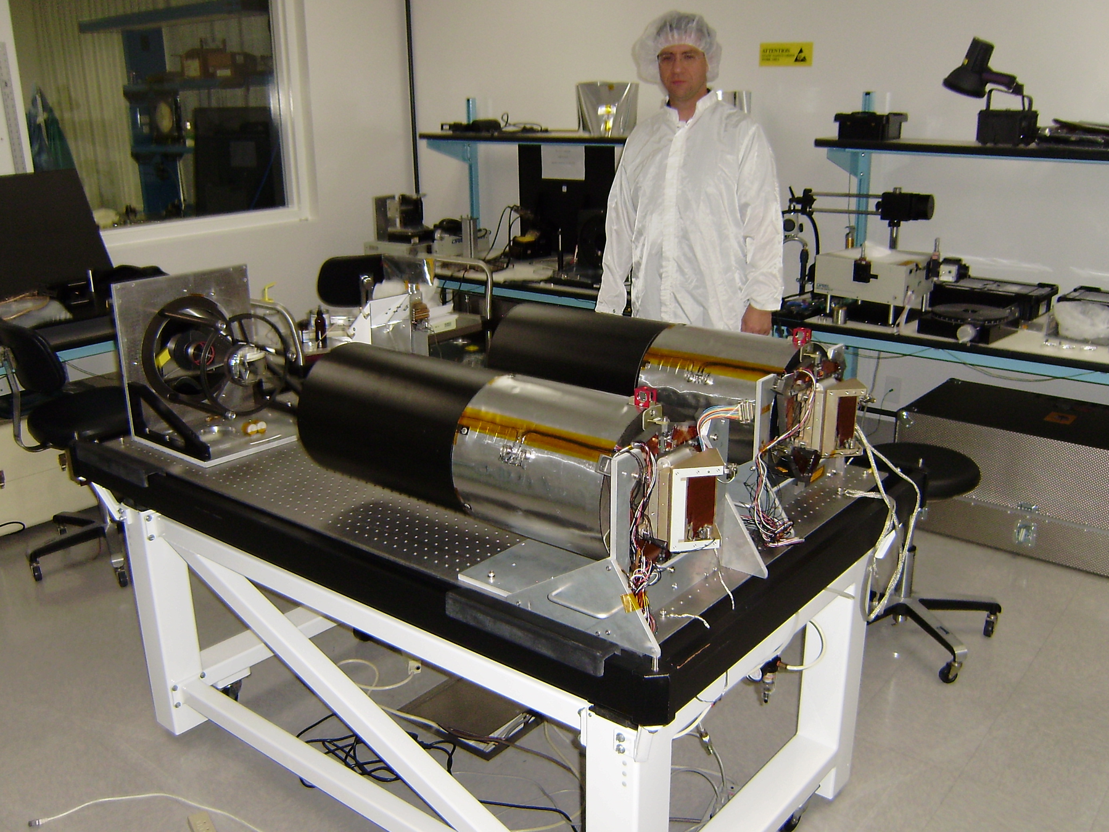
WAC
NACs
MSSS Calibration Facility, Ravine for scale

Slide 3
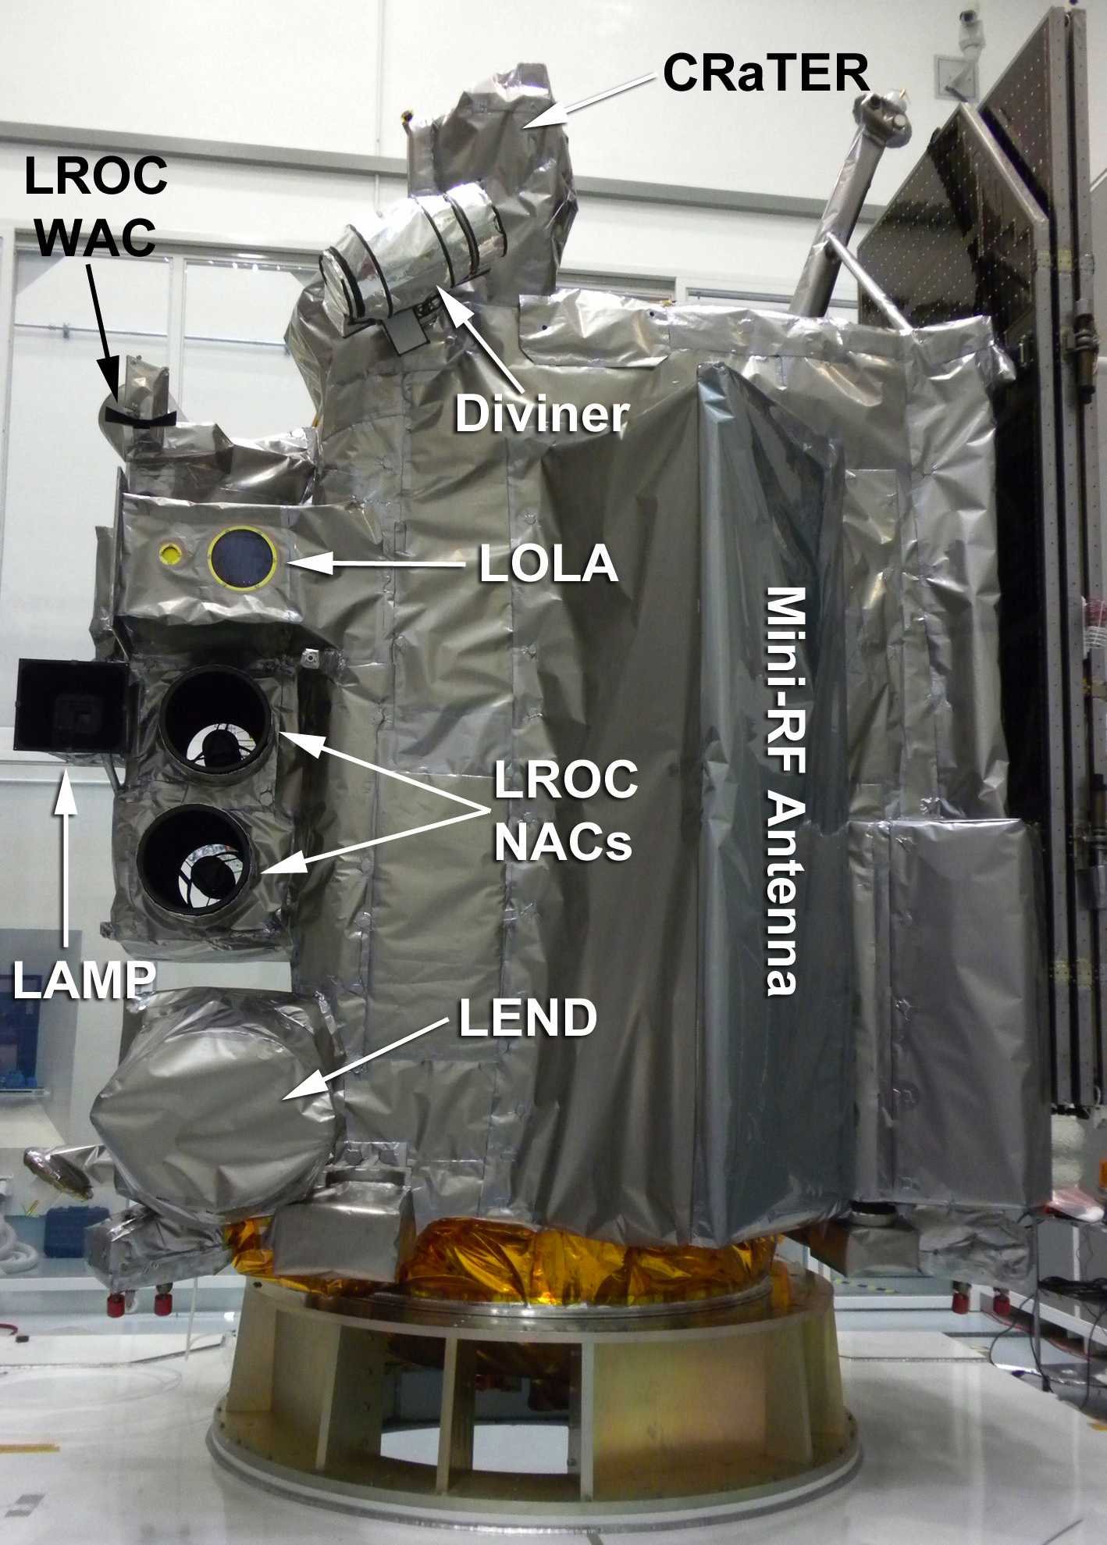
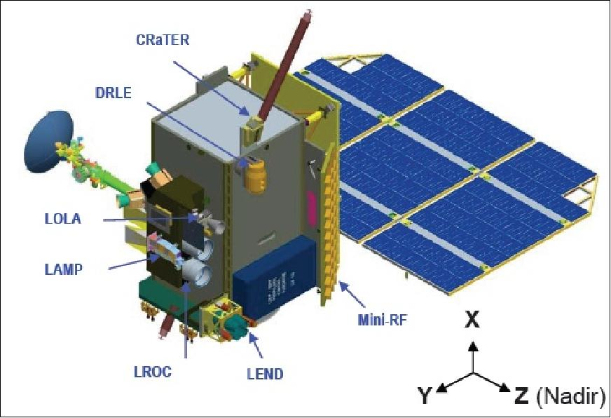
Two cameras
Based on Mars CTX
700 mm focal length
IFOV 10 μrad
Cross track FOV 2.85°
Cross trace FOV 5 km
Samples at 12 bits, companded to 8 bits
Kodak KLI-5001G
5064 element CCD 7 μm pixels
NAC-L off pointed 2.85° two arrays overlap by 135 pixels

Slide 4
NAC Performance
Parameter | NAC-L | NAC-R
FOV | 2.8502° | 2.8412°
IFOV (nadir) | 10.0042 μrad | 9.9764 μrad
max image @ 50 km | 2.49 x 26.1 km | 2.48 x 26.1 km
f# | 3.577 | 3.590
SNR (mare 70° inc. ang.) | >42 | >42
Detector noise | 101 ± 7 e⁻ | 97 ± 1 e⁻
Detector full well | 334,000 ± 31,000 e⁻ | 352,000 ± 4,100 e⁻
Spectral response | 400-760 nm | 400-760 nm
Lossless compression | 1.7:1

Slide 5
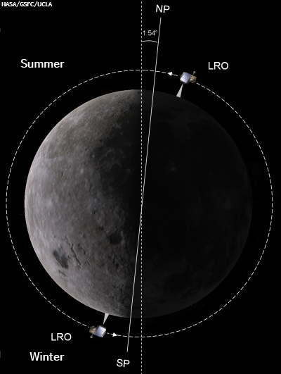
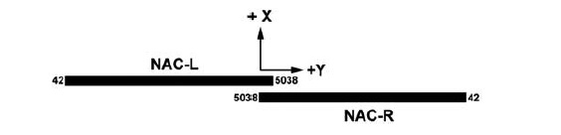
LRO Orbit

Slide 6
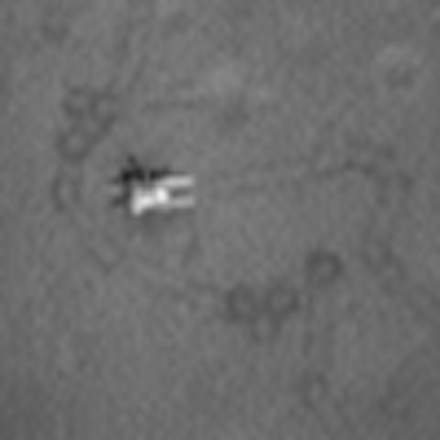
LROC NAC
M127159138L
Original frame: Calibrated, but not map projected, scale: 0.398 m/pixel
5064 samples / 52224 lines
Processed frame: Calibrated and map projected. Orthographic projection, 0.3 m/pixel
6477 samples x 82672 lines
100 x 100 pixels

Slide 7
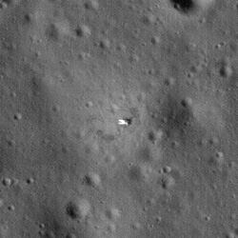
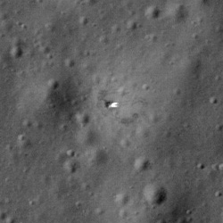
Luna 17 Lander
250 px x 250 px
Unprojected
Projected

Slide 8
Image | Original Scale (m) | Map Scale (m) | PHA ° | INC ° | EMA °
M104747893LE | 1.6 | 1.4 | 61.43 | 59.83 | 1.81
M107106240LE | 1.73 | 1.4 | 45.91 | 44.87 | 1.82
M1103787673RE | 1.57 | 1.4 | 41.57 | 41.92 | 1.23
M1106145059LE | 1.56 | 1.4 | 56.28 | 54.82 | 1.80
M1106145059RE | 1.55 | 1.4 | 54.08 | 55.02 | 1.23
M1108503260LE | 1.55 | 1.4 | 76.31 | 74.57 | 1.79
M1116764100RE | 1.41 | 1.4 | 38.05 | 38.50 | 1.23
M114185541RE | 0.51 | 0.35 | 65.37 | 66.42 | 1.16
M127159138LE | 0.4 | 0.35 | 42.55 | 46.42 | 5.73
M131875063RE | 0.42 | 0.35 | 63.95 | 85.00 | 21.12
M131881859LE | 0.41 | 0.35 | 98.02 | 84.31 | 13.74
M133057617LE | 0.51 | 0.35 | 92.84 | 84.66 | 8.21
M135418902RE | 0.51 | 0.35 | 62.77 | 65.29 | 2.70
M142495666RE | 0.51 | 0.35 | 48.30 | 44.88 | 5.66
M147210569RE | 0.49 x 0.98 | 0.35 | 80.43 | 81.57 | 1.16
M148395010LE | 0.39 x 0.79 | 0.35 | 73.42 | 87.79 | 14.39

Slide 9
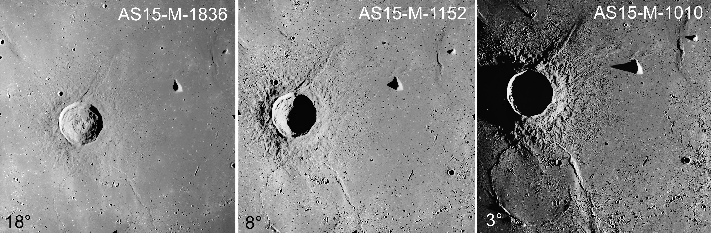
Illumination Effects

Slide 10
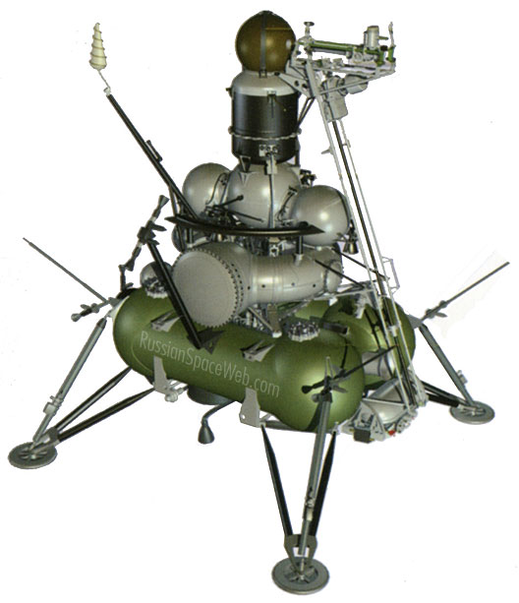
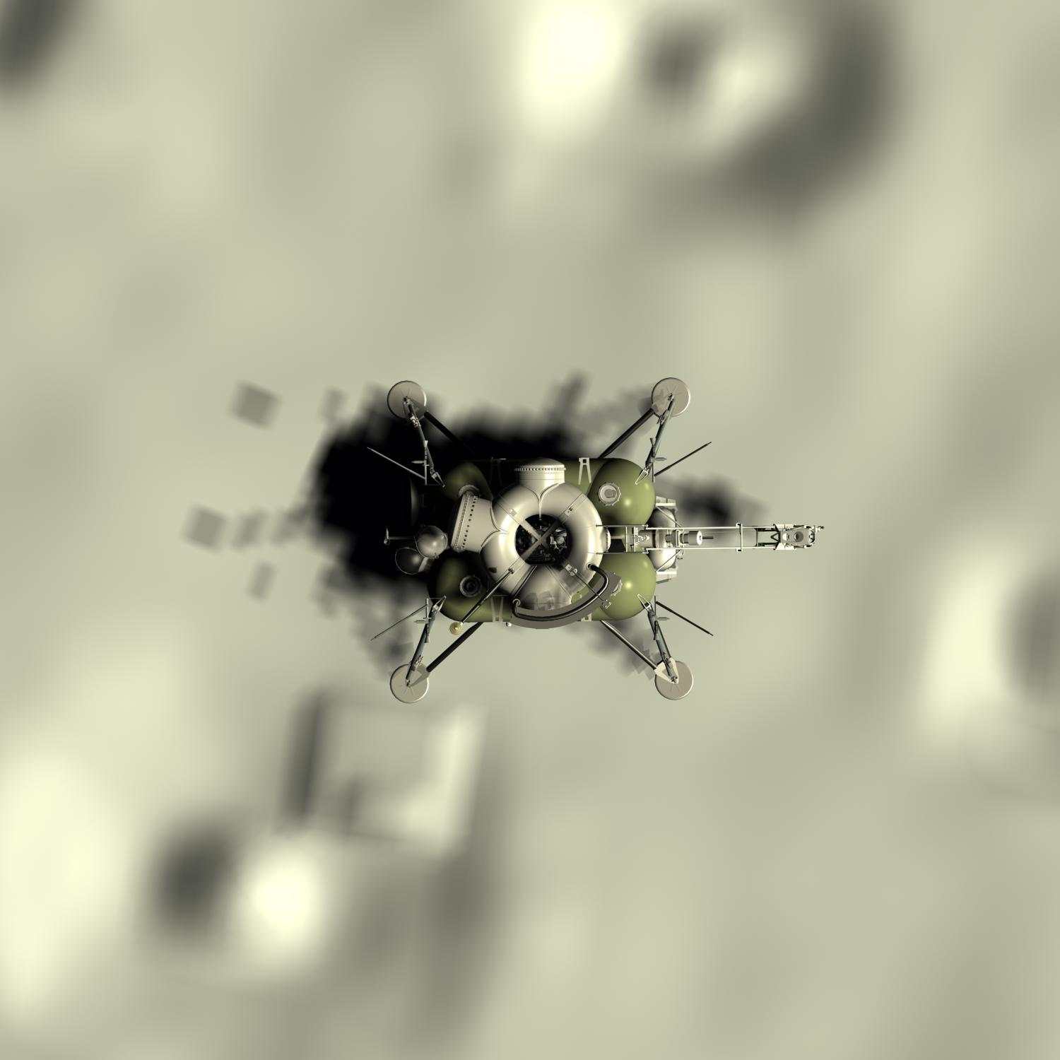
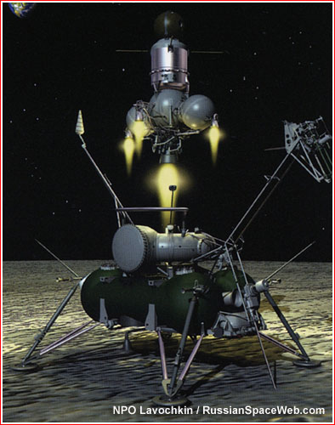
Luna Sample Return Mission Spacecraft

Slide 11
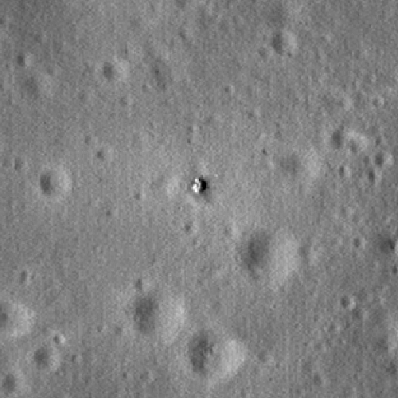
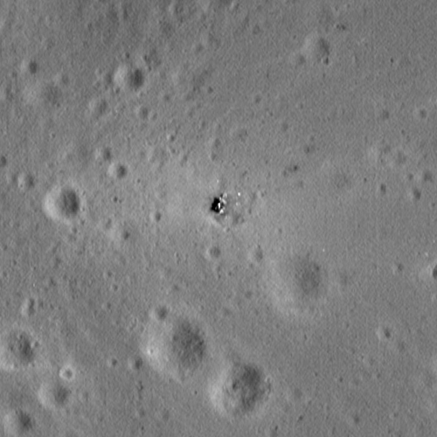
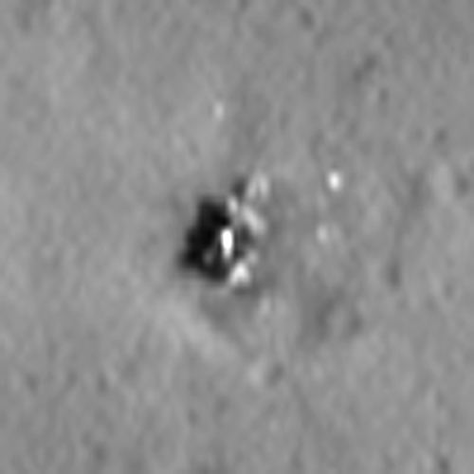
Luna 16

Slide 12
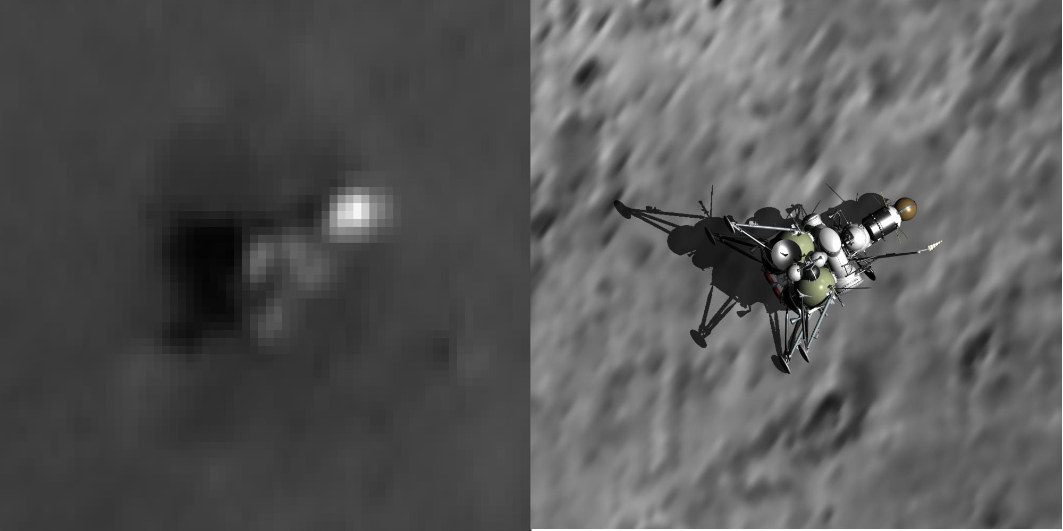
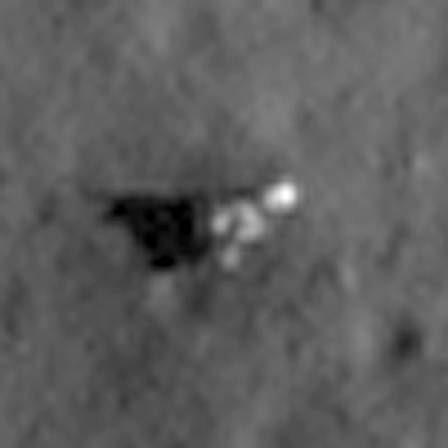
Luna 23

Slide 13
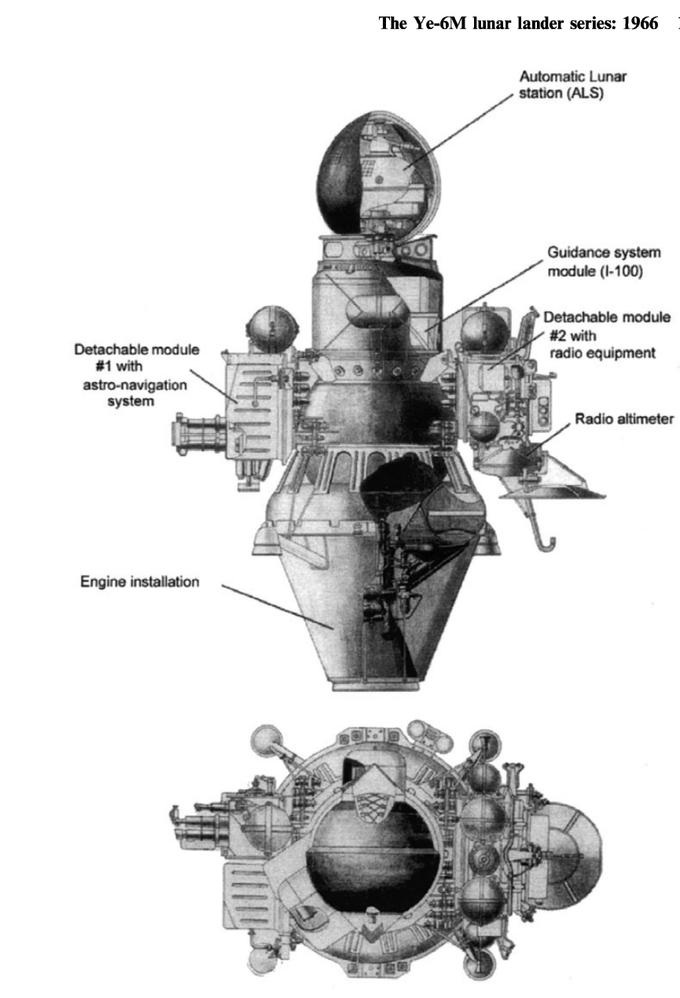
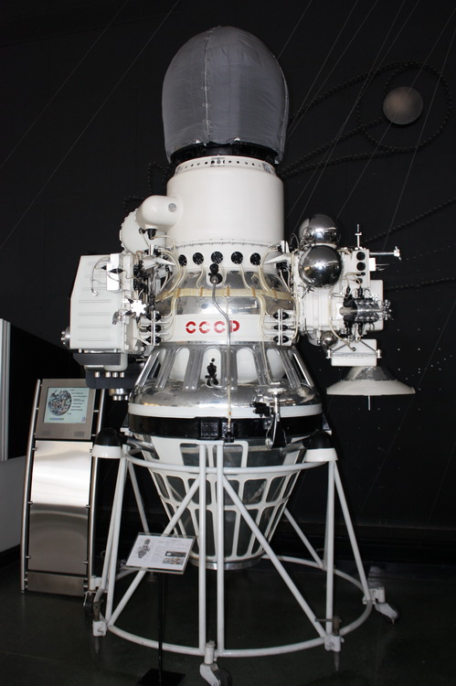
Luna 9 and 13

Slide 14
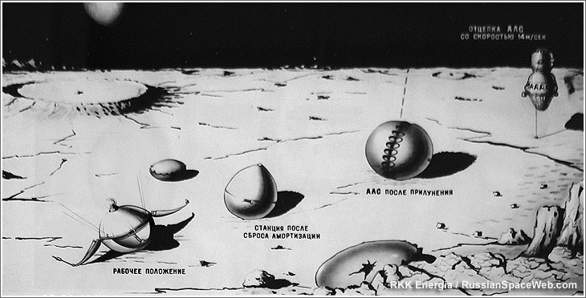
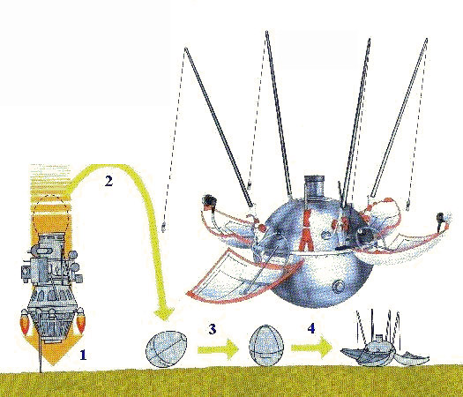
Luna 9 and 13 Landing Events
Deorbit from 75 km
Engine fires for 48 seconds
25 km engine shut down / airbags inflate, tanks jettisoned
Retro rocks shut off ~250 m
Vernier thrusters ignite
5 m probe touches surface releases surface station

Slide 15
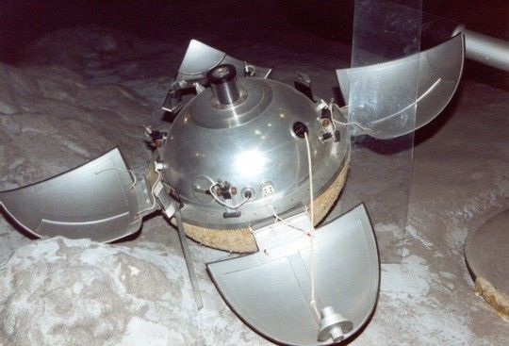
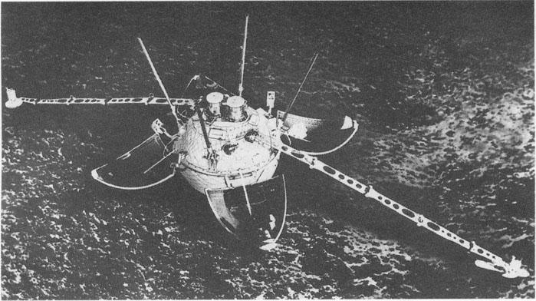
Luna 9 and 13

Slide 16
Spacecraft Characteristics
Luna 9
Launch mass: 1538 kg
Landing System:
Height: 2.7 m
Lander
Mass: 105 kg
Diameter: 58 cm / 160 cm open
Power: Primary battery
Payload: 5 kg
Instruments:
Panoramic Camera
Radiation Detector
Landing Site: 7.13°N / 295.63°E
Tilted 15° moved to 22.5°
Rim of 25 m crater
Luna 13
Launch mass: 1620 kg
Lander: 113 kg
Instruments:
Dual panoramic camera
Radiation detector
Infrared radiometer
Penetrometer
Gamma-ray radiation backscatter
Accerlerometer
Two 1.5 m long arms
Landing Site: 18.87°N / 297.95°E

Slide 17
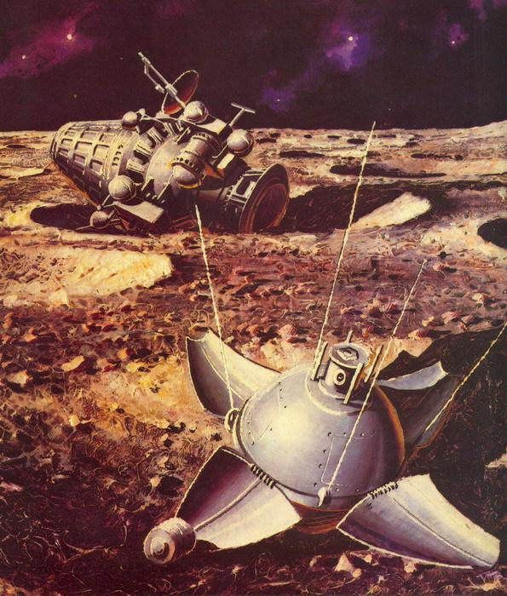
Luna 9 and 13

Slide 18
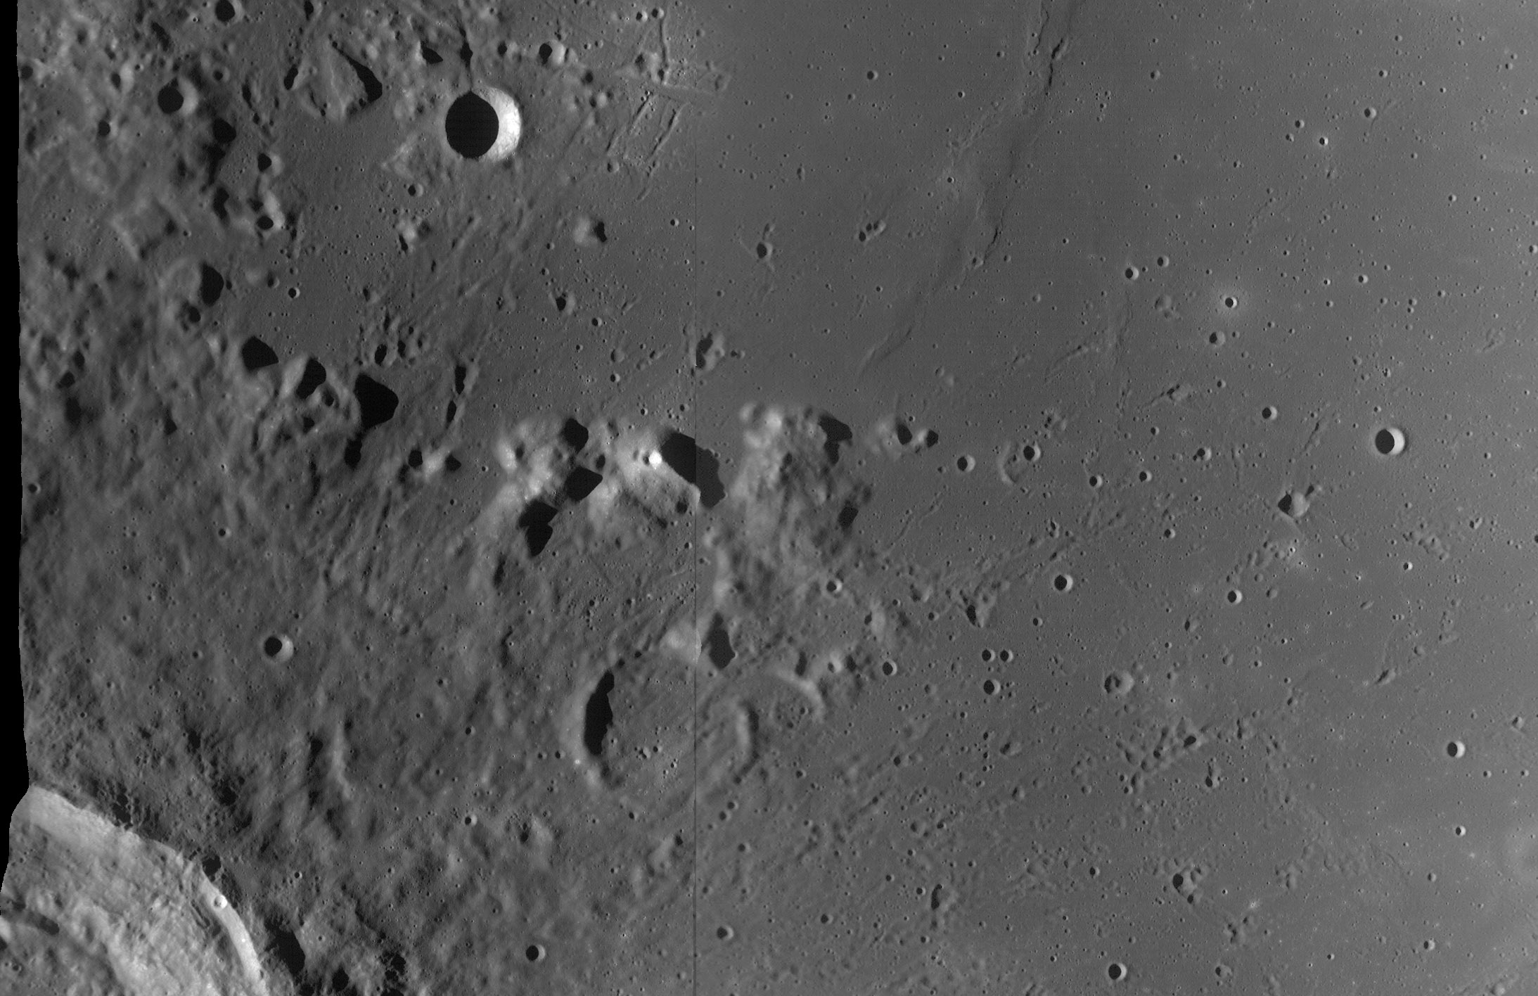
Luna 9

Slide 19
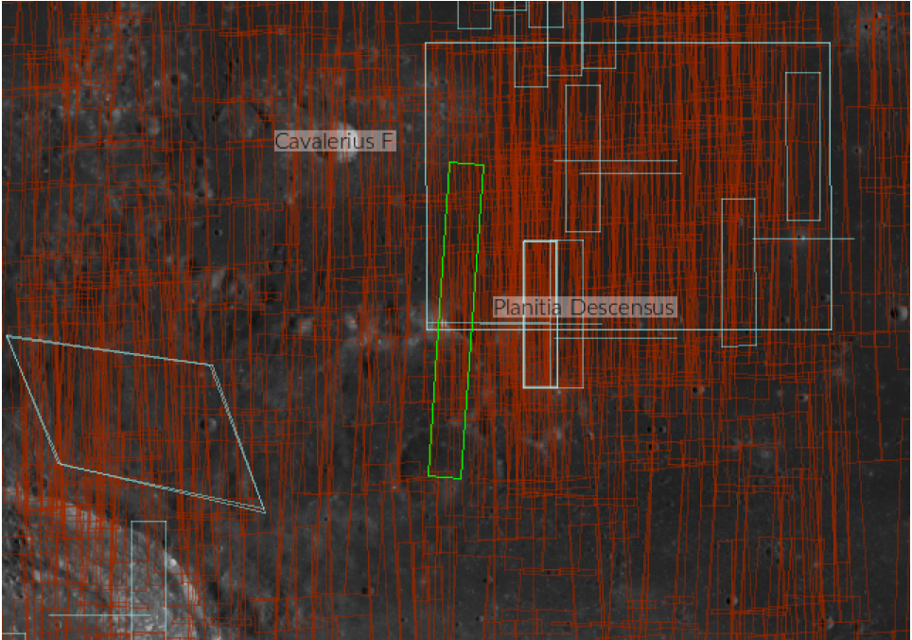
Luna 9 ROI

Slide 20
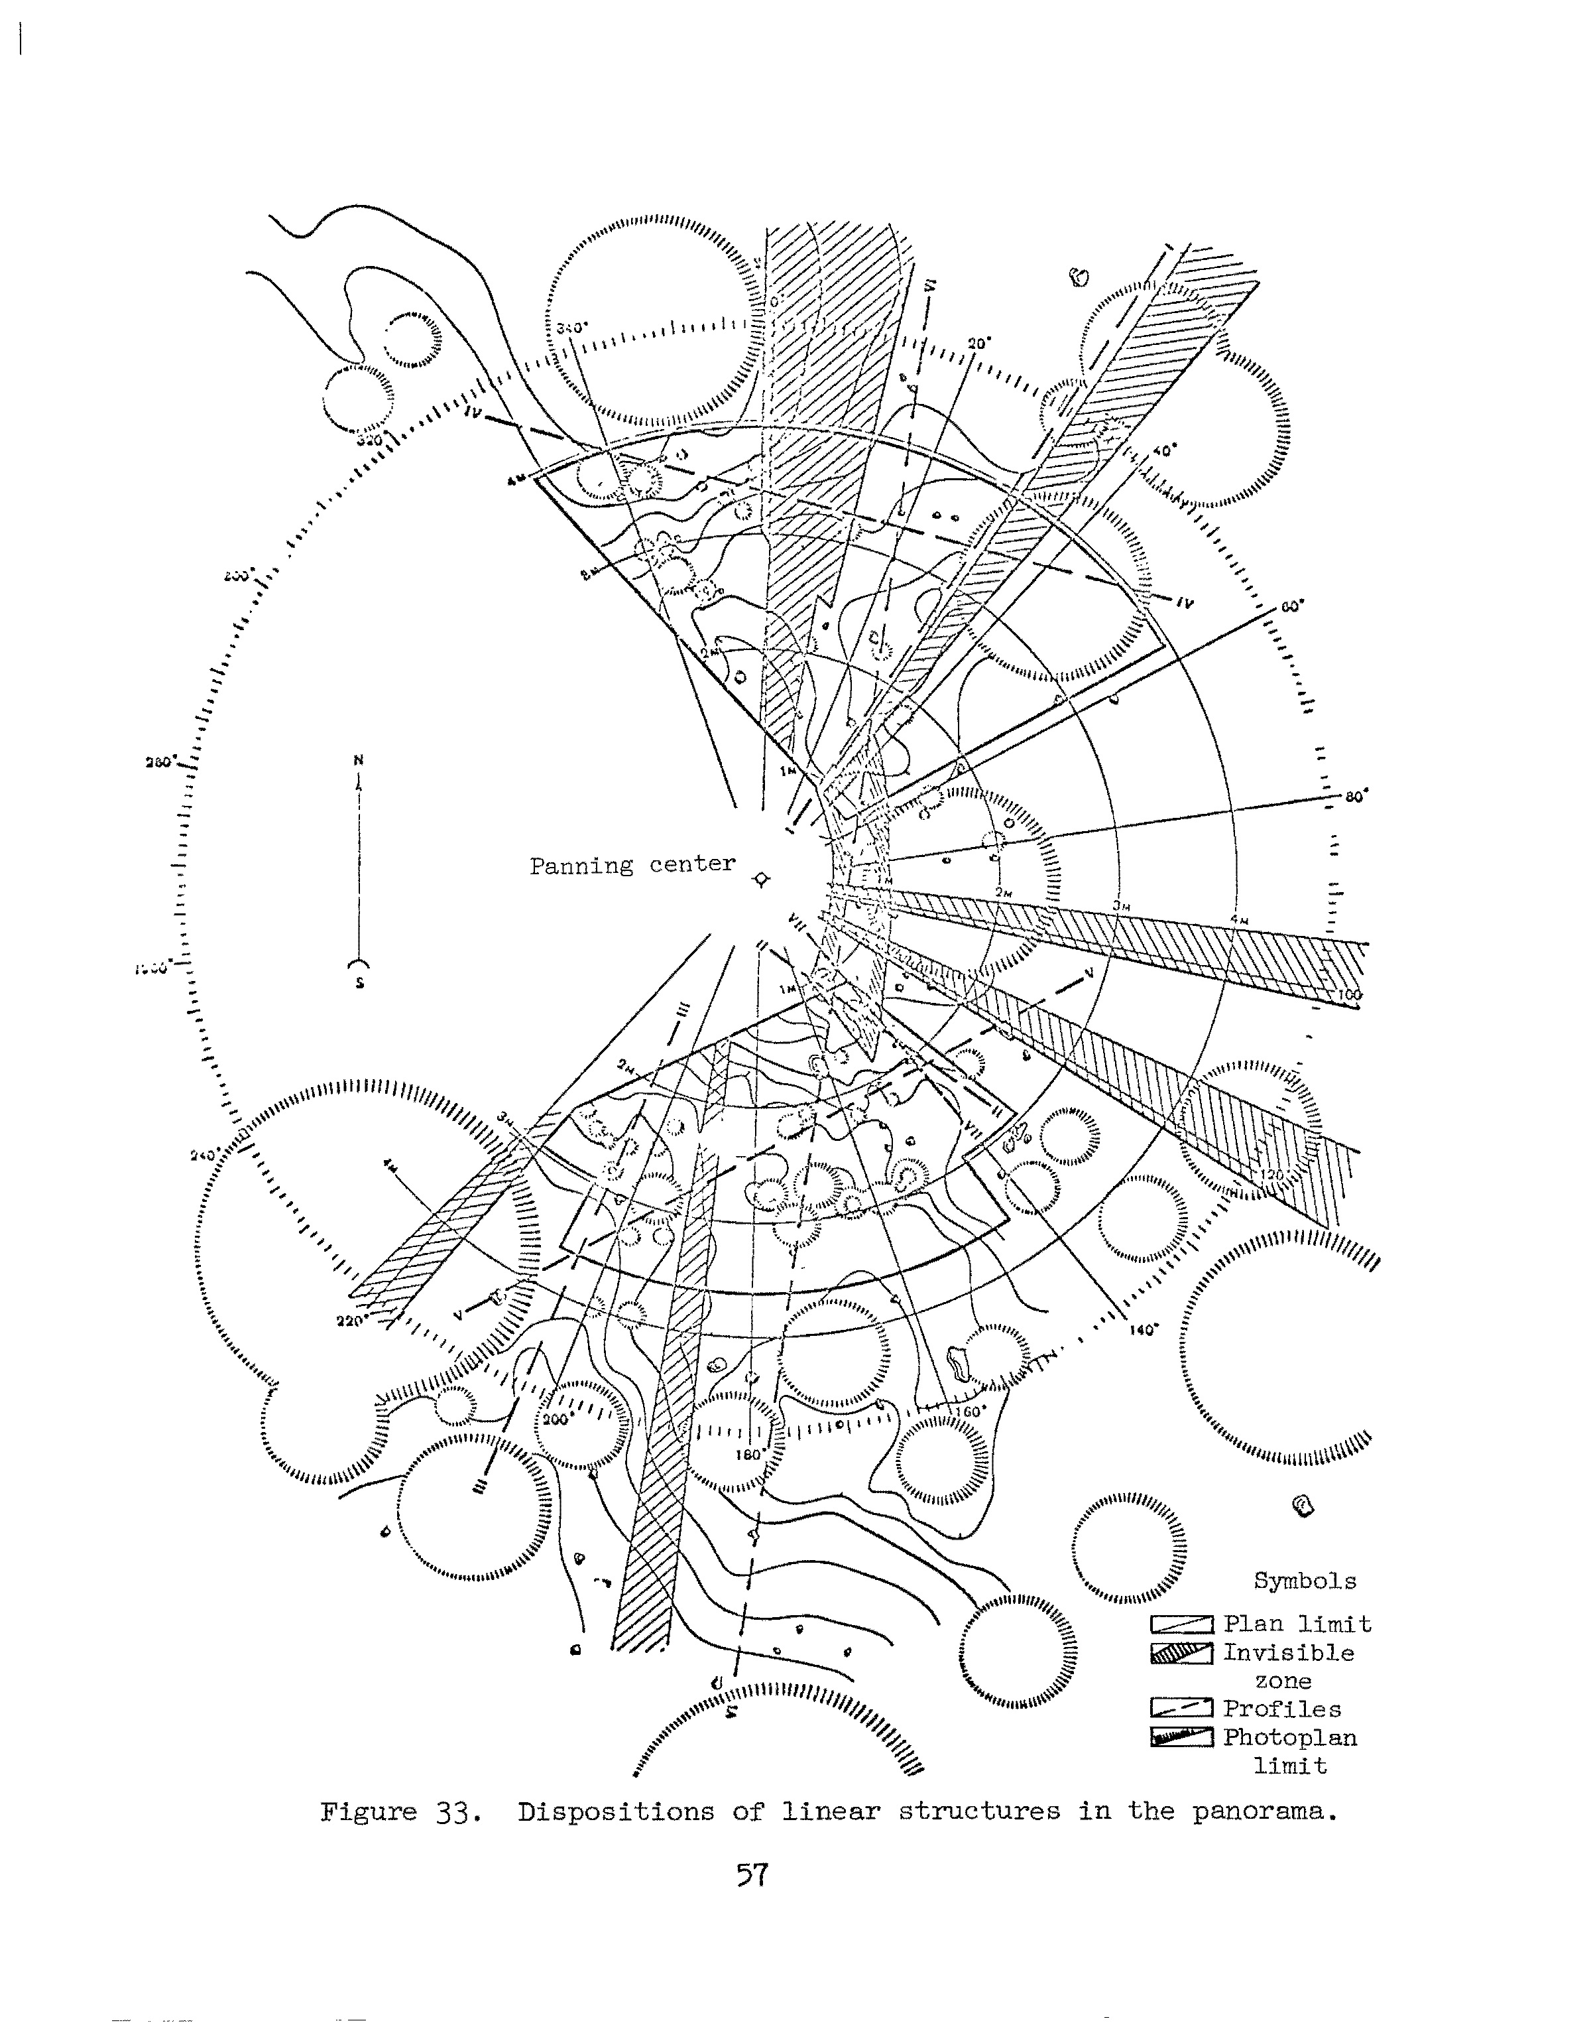
Luna 9 Topography

Slide 21
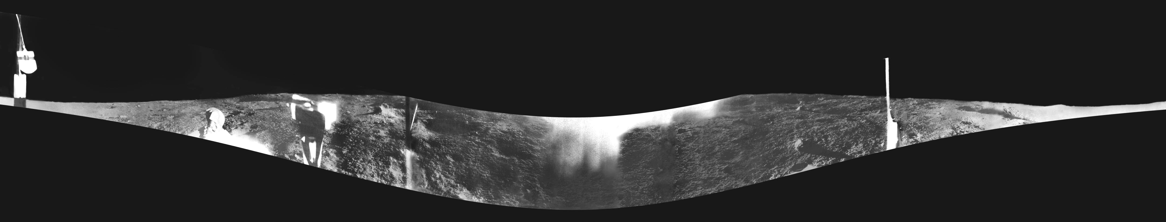
Luna 9 View of the lunar surface

Slide 22
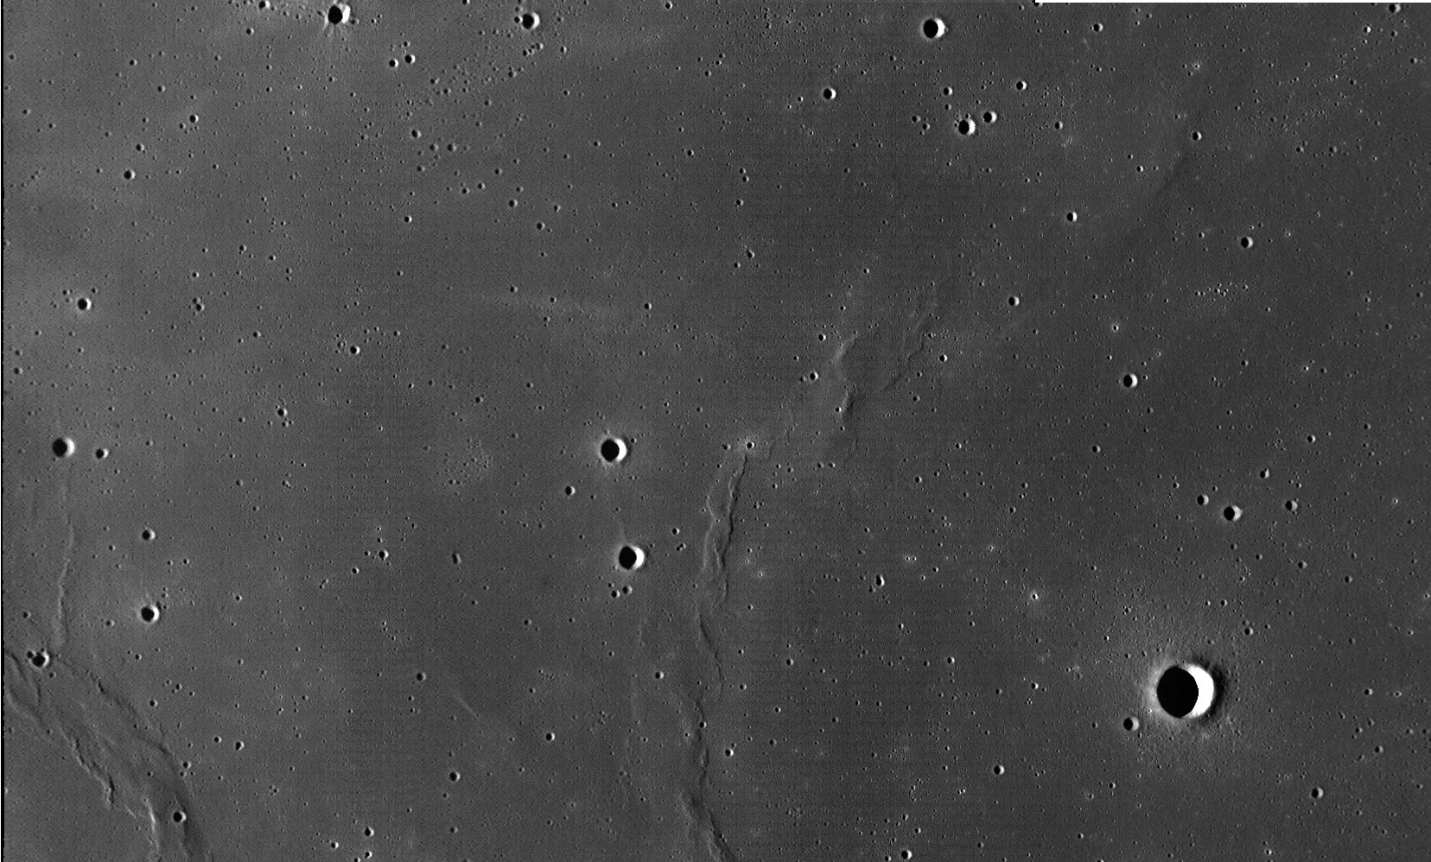
Luna 13

Slide 23
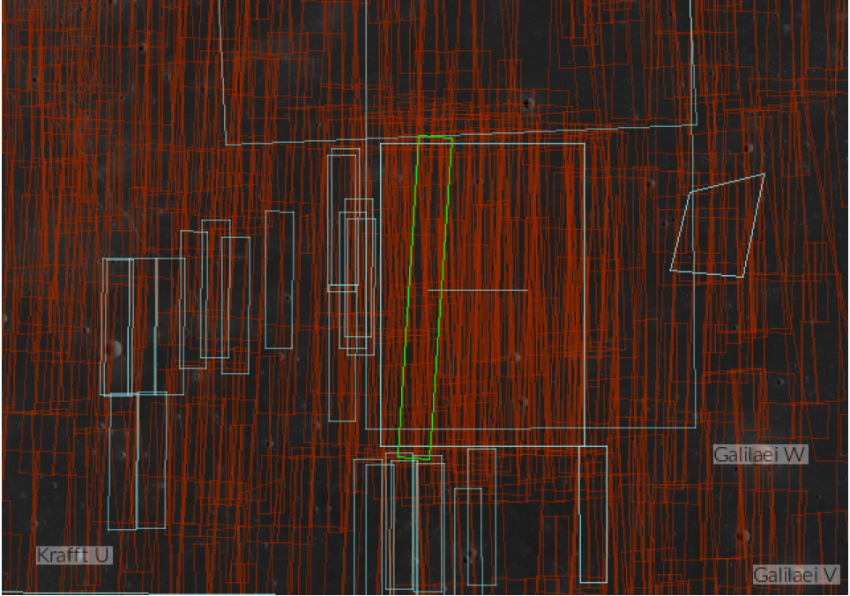
Luna 13 ROI

Slide 24
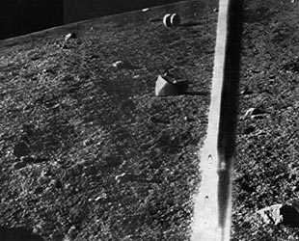
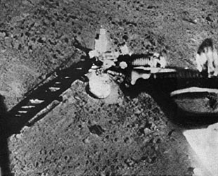
Luna 13 View of the lunar surface

